Slide 1
Unit – 2
Part-1 : Sorting
Part-2 : Complexity
Part-3 : Advance Data Structures
Unit Outcomes:
Ability to understand mathematical formulation, complexity analysis and methodologies to solve recurrence relations for algorithms.
Ability to apply algorithm design principles to derive solutions for real life problems and comment on complexity of solution.

Slide 2
UNIT-2: (i) Sorting

Slide 3
Sorting
Insertion sort and its analysis
Selection sort and its analysis
Heap sort and its analysis
Sorting: Arranging elements in ascending or descending order.

Slide 4
Insertion Sort
Principle: Select an element from given array and place it proper position by scanning and comparing all the elements present before the selected element.
Sorting process is expands at each stage.
This method does not require all elements to be referred at one stage.
For an array of size “n”, maximum “n-1” comparisons are required.

Slide 5
Example
1 | 2 | 3 | 4 | 5 | 6 | 7
22 | 11 | 55 | 44 | 33 | 77 | 66
Array:
Pass 1: Pointer at location 2: comparison up to location 1.
Swap values of value at a[i] and a[i-1] if (a[i] < a[i-1])
For example at location: 5
Array will be in the form: 11, 22, 44, 55, (33)
So i=5 and i-1=4: Compare and swap: Continue till condition is satisfied.
Continue till n-1 passes

Slide 6
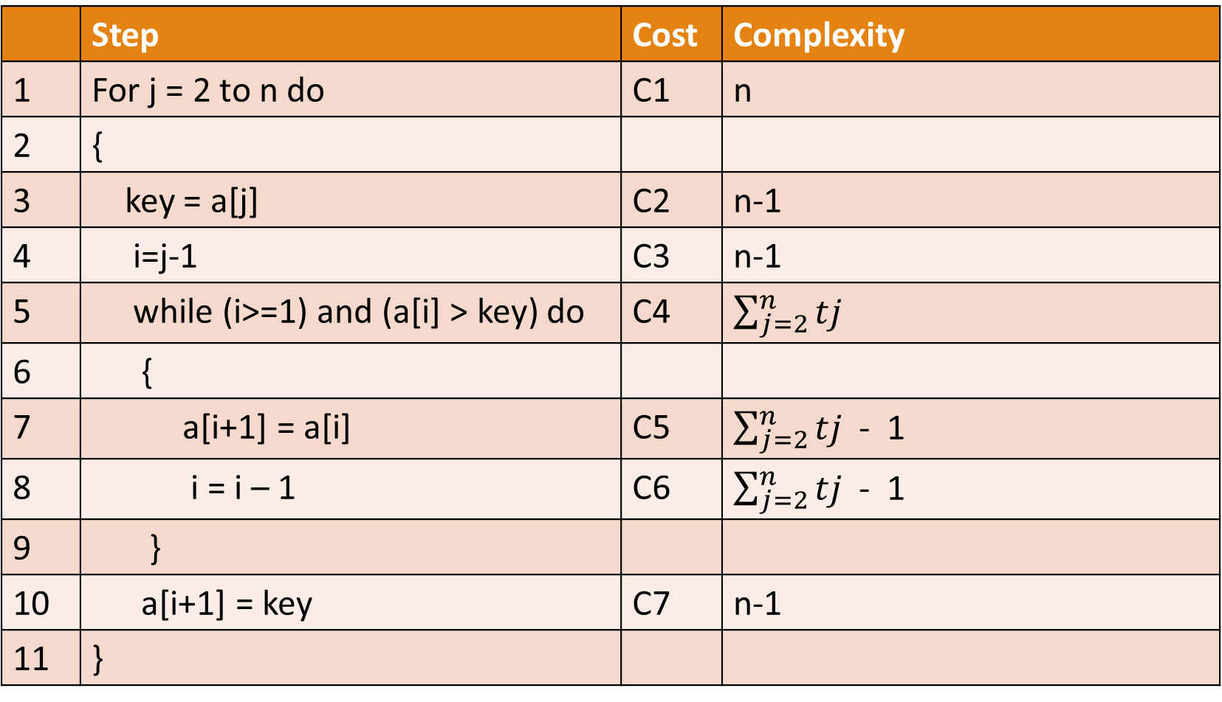
 | Step | Cost | Complexity
1 | For j = 2 to n do | C1 | n
2 | {
3 | key = a[j] | C2 | n-1
4 | i=j-1 | C3 | n-1
5 | while (i>=1) and (a[i] > key) do | C4 | $\sum_{j=2}^{n}{tj}$
6 | {
7 | a[i+1] = a[i] | C5 | $\sum_{j=2}^{n}{tj}$ - 1
8 | i = i – 1 | C6 | $\sum_{j=2}^{n}{tj}$ - 1
9 | }
10 | a[i+1] = key | C7 | n-1
11 | }

Slide 7
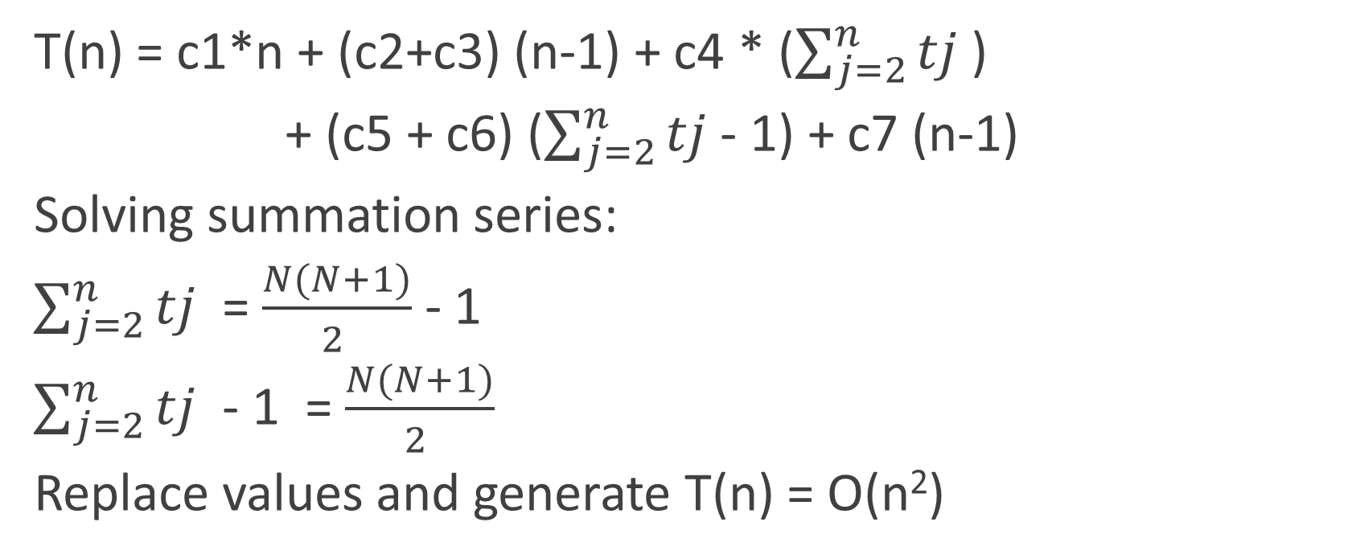
Complexity
T(n) = c1*n + (c2+c3) (n-1) + c4 * ($\sum_{j=2}^{n}{tj}$ )
+ (c5 + c6) ($\sum_{j=2}^{n}{tj}$ - 1) + c7 (n-1)
Solving summation series:
$\sum_{j=2}^{n}{tj}$ = $\frac{N(N+1)}{2 }$ - 1
$\sum_{j=2}^{n}{tj}$ - 1 = $\frac{N(N+1)}{2 }$
Replace values and generate T(n) = O(n²)

Slide 8
Selection Sort
Principle: Select the suitable position for an element of array.
The sorting is performed on array by finding minimum element in each iteration and storing it.
Once the array for a[1..i] is generated it is not altered and value of position a[i] is obtained.

Slide 9
Example
1 | 2 | 3 | 4 | 5 | 6 | 7
22 | 11 | 55 | 44 | 33 | 77 | 66
Array:
Pass 1: Pointer at location 1: Compare value with all elements and find out minimum value.
If minimum value is less than value at location, then perform swapping.
For example at position: 5: array structure would be
11 22 33 44, (55, 66,77) so out of remaining elements smallest is found and stored.
No change is permitted for 11, 22, 33, 44.

Slide 10
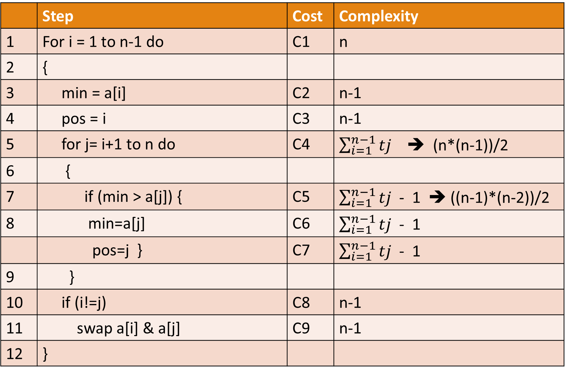
 | Step | Cost | Complexity
1 | For i = 1 to n-1 do | C1 | n
2 | {
3 | min = a[i] | C2 | n-1
4 | pos = i | C3 | n-1
5 | for j= i+1 to n do | C4 | $\sum_{i=1}^{n−1}{tj}$ ➔ (n*(n-1))/2
6 | {
7 | if (min > a[j]) { | C5 | $\sum_{i=1}^{n−1}{tj}$ - 1 ➔ ((n-1)*(n-2))/2
8 | min=a[j] | C6 | $\sum_{i=1}^{n−1}{tj}$ - 1
 | pos=j } | C7 | $\sum_{i=1}^{n−1}{tj}$ - 1
9 | }
10 | if (i!=j) | C8 | n-1
11 | swap a[i] & a[j] | C9 | n-1
12 | }

Slide 11
Heap Sort
Principle: Fastest sorting method with complexity of O(nlogn).
Based on arranging the elements using tree structure.
Steps:
  Build Heap
  Insert
  Delete maximum
  Adjust

Slide 12
Heap sort: Insert algorithm
Algorithm insert(a, n, item)
{
i = n; a[i] = item;
while (i>1) and (a[i/2] < item) do
{
a[i] = a[i/2] // lb
i = i/2
}
a[i] = item
}

Slide 13
Heap Sort: Delete maximum
Algorithm delmax(a,n,x)
{
if(n=0)
write(“No element for deletion”)
else
{
x=a[i];
a[1] = a[n]
adjust(a,1,n-1)
}
}

Slide 14
Heap sort: Adjust algorithm
Algorithm adjust(a,i,n)
{
item=a[i]
j=2i
while (j<= n) do
{
if(a[j] < a[j+1])
j=j+1;
if(item >=a[j])
break;
a[j/2] = a[j] //lb
j=2j
}
a[j/2] = item; //LB
}

Slide 15
