Slide 1
Unit 3 (Part-I): Greedy Algorithms

Slide 2
Expected Outcomes of topic (CO)
Understand problem and its formulation to design an algorithm
Demonstrate the knowledge of basic data structures and their implementation and decide upon use of particular data structure best suited for implementing solution.
Write efficient algorithms using Greedy, Divide & Conquer to solve the real life problems.
Trace logic formulation, execution path of particular algorithm and data generated during execution of algorithm.

Slide 3
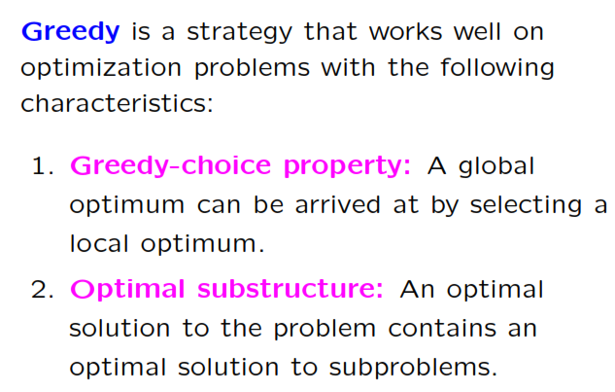
Basic Characteristics – Greedy algorithms

Slide 4
Greedy Algorithms
Characteristics
Greedy Algorithms are short – sighted.
Greedy Algorithms are most efficient if it works.
For every instance of input Greedy Algorithms makes a decision and continues to process further set of input.
The other input values at the instance of decision are lost and not used in further processing.
A
A
5
8
5
8
S
D
S
D
t
y
9
2
B
x

Slide 5
Greedy Algorithm: Knapsack Problem
Principle: Knapsack is a bag of fixed capacity.
In this problem it is assumed that “n” objects with profit value and weight are given.
The main objective is to select the objects and place them in knapsack such that the object placed in the bag will generate maximum profit.
Two types of Knapsack problems:
Fractional Knapsack problem
0/1 Knapsack problem
The Fractional Knapsack problem can be solved using Greedy approach, where as 0/1 Knapsack problem does not have greedy solution.

Slide 6
Representation
Capacity = 20
10/2
9/4
15/3
6/6
4/1
11/5

Slide 7
Greedy Algorithm: Knapsack Problem
Approaches:
There are three basic approaches to solve knapsack problem:
Select the maximum profit objects
Select the minimum weight objects
Select the objects based on Profit/Weight ratio

Slide 8
Significance
TIME
PROFIT
Process for execution
Generate maximum Profit in available time by proper selection of processes

Slide 9
Greedy Algorithm: Knapsack Problem
Example 1: Capacity = 15, number of objects = 7
Profit | 10 | 5 | 15 | 7 | 6 | 18 | 3
Weight | 2 | 3 | 5 | 7 | 1 | 4 | 1
Index | 1 | 2 | 3 | 4 | 5 | 6 | 7
Approach: Maximum Profit
Object | Weight | Profit | Capacity Remaining | Partial/Complete
O6 | 4 | 18 | 15-4=11 | C
O3 | 5 | 15 | 11-5=6 | C
O1 | 2 | 10 | 6-2=4 | C
O4* | 4 | 4 | 4-4=0 | P
TOTAL | 15 | 47 | 0

Slide 10
Greedy Algorithm: Knapsack Problem
Example 1: Capacity = 15, number of objects = 7
Profit | 10 | 5 | 15 | 7 | 6 | 18 | 3
Weight | 2 | 3 | 5 | 7 | 1 | 4 | 1
Index | 1 | 2 | 3 | 4 | 5 | 6 | 7
Approach: Minimum Weight
Object | Weight | Profit | Capacity Remaining | Partial/Complete
O5 | 1 | 6 | 15-1=14 | C
O7 | 1 | 3 | 14-1=13 | C
O1 | 2 | 10 | 13-2=11 | C
O2 | 3 | 5 | 11-3=8 | C
O6 | 4 | 18 | 8-4=4 | C
O3* | 5(4) | 12 | 4-4=0 | P
TOTAL | 15 | 54 | 0

Slide 11
Greedy Algorithm: Knapsack Problem
Example 1: Capacity = 15, number of objects = 7
Profit | 10 | 5 | 15 | 7 | 6 | 18 | 3
Weight | 2 | 3 | 5 | 7 | 1 | 4 | 1
Ratio | 5.0 | 1.6 | 3.0 | 1.0 | 6.0 | 4.5 | 3.0
Index | 1 | 2 | 3 | 4 | 5 | 6 | 7
Approach: Maximum Pi/Wi ratio
Object | Weight | Profit | Capacity Remaining | Partial/Complete
O5 | 1 | 6 | 15-1=14 | C
O1 | 2 | 10 | 14-2=12 | C
O6 | 4 | 18 | 12-4=8 | C
O3 | 5 | 15 | 8-5=3 | C
O7 | 1 | 3 | 3-1=2 | C
O2* | 3(2) | 10/3=3.33 | 2-2=0 | P
TOTAL | 15 | 55.3 | 0

Slide 12
Greedy Algorithm: Knapsack Problem
Example 2: Capacity = 18, number of objects = 7
Pi | 9 | 15 | 12 | 4 | 6 | 16 | 8
Wi | 2 | 3 | 5 | 4 | 3 | 6 | 3
Ratio | 4.5 | 5.0 | 2.4 | 1.0 | 2.0 | 2.6 | 2.6
Index | 1 | 2 | 3 | 4 | 5 | 6 | 7
Maximum (Pi/Wi) Ratio
Object | Weight | Profit | Capacity Remaining | Partial/Complete

Slide 13
Exam Questions

Slide 14
Knapsack Problem: Algorithm
Data Structures:
Weight array: W[n] ➔ To store weight values
Profit array: P[n] ➔ To store profit values
Capacity ➔ Given and will decrease after each step
X[n] ➔ To store 0, 1 or fraction depending upon object placement
Weight = 0 (initially) and will increase towards capacity
Profit = 0 and will be calculated by X[i] and P[i]
Process: To select the object with best Pi/Wi Ratio. (Sorting)

Slide 15
Knapsack Algorithm
Initialization steps:
Profit
Weight
x[1..n] ➔ to hold data about object placement [partly, completely, rejected]
Decision step
While ( condition )
Select object //Call function for selecting best suited object//
Place in bag {Completely / Partially }
Update x [i]
Final step: Find profit
Multiply x[i] and associated profit

Slide 16
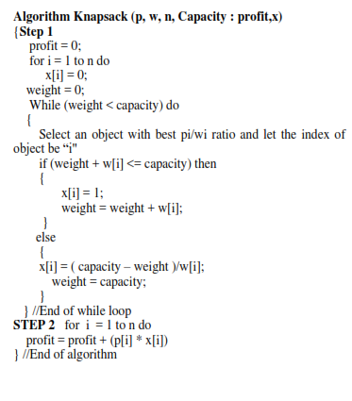

Slide 17
Greedy Algorithms on Graph
Prim’s Algorithm
Kruskal Algorithm
Single Source shortest Path Algorithm (Dijkstra’s Algorithm)

Slide 18
Minimum Cost Spanning Tree
Given a graph G =(V,E) V=Number of vertices and E=Number of edges, then Spanning tree is tree generated from graph, with characteristics
All the vertices present in the tree
There is no cycle in the tree i.e., e=v-1
Subset of edges, that forms a tree, where total cost of edges is minimum.
Minimum cost spanning tree is a spanning tree with “edges of minimum cost”.
Applications:
To transmit the message without broadcasting.
To generate travel plan in minimum cost.
Designing network, home electric wiring etc.
Approaches: Prims’ Method and Kruskals’ Method.

Slide 19
Minimum Cost Spanning Tree
Principle:
Select an edge of minimum cost. The edge will derive two vertices.
Continue the process from one of the vertex by selecting the next edge of minimum cost.
Once the vertex is visited, then it is marked.
The process will attempt to visit unmarked vertices and terminates when all the vertices are visited.
Process guarantees no cycle in the tree.
“What if the process of tree generation starts from any arbitrary vertex”.
Motivation: To join points as cheaply as possible: Applications in clustering and networking
Acyclic graph to connect all nodes in minimum cost.
One of the term in U.S. legal code (AT&T)

Slide 20
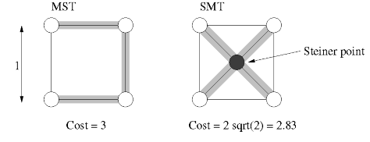
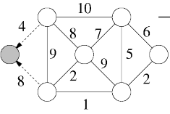
Graphs for Examples
Steiner Spanning Tree

Slide 21
Spanning tree: Free tree
A free tree has following properties
Exactly n-1 edges for “n” vertices
There exists a unique path between two vertices.
By adding an edge, a cycle will be created in free tree. Breaking any edge on the cycle restores the free tree.
Greedy: Minimization problem.
Repeated selection: of minimum cost edges with certain test cases.
Once decision of adding edge is finalized, it cannot be revoked.
Basic idea: To generate subset of “E” connecting all “V”

Slide 22
Minimum Cost Spanning Tree: Prim’s method
Example:
Consider the following graph:
Select an edge of minimum cost.
From selected vertex continue selecting
edge of minimum cost
 | 1 | 2 | 3 | 4 | 5 | 6
1 | 99 | 10 | 99 | 30 | 45 | 99
2 | 10 | 99 | 50 | 99 | 40 | 25
3 | 99 | 50 | 99 | 99 | 35 | 15
4 | 30 | 99 | 99 | 99 | 99 | 20
5 | 45 | 40 | 35 | 99 | 99 | 55
6 | 99 | 25 | 15 | 20 | 55 | 99
1
10
2
50
30
45
40
3
4
25
5
35
6
1
2
20
55
15
3
4
5
6

Slide 23
Minimum Cost Spanning Tree: Prim’s method
Example:
Consider the following graph:
 | 1 | 2 | 3 | 4 | 5 | 6
1 | 99 | 10 | 99 | 30 | 45 | 99
2 | 10 | 99 | 50 | 99 | 40 | 25
3 | 99 | 50 | 99 | 99 | 35 | 15
4 | 30 | 99 | 99 | 99 | 99 | 20
5 | 45 | 40 | 35 | 99 | 99 | 55
6 | 99 | 25 | 15 | 20 | 55 | 99
1
10
2
50
45
40
The next vertex should be the vertex reachable in minimum cost either from vertex 1 or vertex 2
30
3
4
25
5
35
6
 | T | C |  | F | R
1 | 1 | - | 1 | 2
2 | 1 | - | 2 | 2
3 | 1 | < | 3 | 2 | F
4 | 1 | < | 4 | 2 | T
5 | 1 | < | 5 | 2 | F
6 | 1 | < | 6 | 2 | F
20
55
15
1
10
2
1 | 2 | 3 | 4 | 5 | 6
- | - | 2 | 1 | 2 | 2
Out of Four possible options: cost[near[j],j] = minimum
Select the index satisfying above condition: 6

Slide 24
Minimum Cost Spanning Tree: Prim’s method
The vertex selected is “6” due to which there may be changes in closeness of vertices.
That the vertices which were close to vertex 1 or vertex 2 may modified due to selection of vertex 6.
Example:
Consider the following graph:
 | 1 | 2 | 3 | 4 | 5 | 6
1 | 99 | 10 | 99 | 30 | 45 | 99
2 | 10 | 99 | 50 | 99 | 40 | 25
3 | 99 | 50 | 99 | 99 | 35 | 15
4 | 30 | 99 | 99 | 99 | 99 | 20
5 | 45 | 40 | 35 | 99 | 99 | 55
6 | 99 | 25 | 15 | 20 | 55 | 99
1
10
2
50
30
45
40
3
4
25
5
35
6
55
 | T | C |  | F | R
1 |  | - | 1
2 |  | - | 2
3 | 6 | < | 3 | 2 | T
4 | 1 | < | 4 | 6 | F
5 | 6 | < | 5 | 2 | F
6 |  | - | 6
20
15
1
10
2
1 | 2 | 3 | 4 | 5 | 6
- | - | 6 | 6 | 2
25
6
1 | 2 | 3 | 4 | 5 | 6
- | - | 2 | 1 | 2 | 2
Out of Four possible options: cost[near[j],j] = minimum
Select the index satisfying above condition: 3

Slide 25
Minimum Cost Spanning Tree: Prim’s method
The vertex selected is “3” due to which there may be changes in closeness of vertices.
That the vertices which were close to vertex 1 or vertex 2 or vertex 6 may modified due to selection of vertex 3.
Example:
Consider the following graph:
 | 1 | 2 | 3 | 4 | 5 | 6
1 | 99 | 10 | 99 | 30 | 45 | 99
2 | 10 | 99 | 50 | 99 | 40 | 25
3 | 99 | 50 | 99 | 99 | 35 | 15
4 | 30 | 99 | 99 | 99 | 99 | 20
5 | 45 | 40 | 35 | 99 | 99 | 55
6 | 99 | 25 | 15 | 20 | 55 | 99
1
10
2
50
30
45
40
3
4
25
5
35
1 | 2 | 3 | 4 | 5 | 6
- | - | - | 6 | 3 | -
 | T | C |  | F | R
1 |  | - | 1
2 |  | - | 2
3 |  | < | 3
4 | 3 | < | 4 | 6 | F
5 | 3 | < | 5 | 2 | T
6 |  | - | 6
20
6
55
15
1
10
2
1 | 2 | 3 | 4 | 5 | 6
- | - | 6 | 6 | 2 | -
25
6
1 | 2 | 3 | 4 | 5 | 6
- | - | 2 | 1 | 2 | 2
3
Out of Four possible options: cost[near[j],j] = minimum
Select the index satisfying above condition: 4
15

Slide 26
Minimum Cost Spanning Tree: Prim’s method
The vertex selected is “4” due to which there may be changes in closeness of vertices.
That the vertices which were close to vertex 1,2,6,3 may modified due to selection of vertex 4.
Example:
Consider the following graph:
 | 1 | 2 | 3 | 4 | 5 | 6
1 | 99 | 10 | 99 | 30 | 45 | 99
2 | 10 | 99 | 50 | 99 | 40 | 25
3 | 99 | 50 | 99 | 99 | 35 | 15
4 | 30 | 99 | 99 | 99 | 99 | 20
5 | 45 | 40 | 35 | 99 | 99 | 55
6 | 99 | 25 | 15 | 20 | 55 | 99
1
10
2
50
45
40
3
1 | 2 | 3 | 4 | 5 | 6
- | - | - |  | 3 | -
30
4
25
5
35
1 | 2 | 3 | 4 | 5 | 6
- | - | - | 6 | 3 | -
 | T | C |  | F | R
1 |  | - | 1
2 |  | - | 2
3 |  | < | 3
4 |  | < | 4 |  | F
5 | 3 | < | 5 | 4 | T
6 |  | - | 6
20
6
55
15
1
10
2
1 | 2 | 3 | 4 | 5 | 6
- | - | 6 | 6 | 2 | -
25
6
4
3
1 | 2 | 3 | 4 | 5 | 6
- | - | 2 | 1 | 2 | 2
20
15

Slide 27
Prim’s method: Output
Example:
Consider the following graph:
 | 1 | 2 | 3 | 4 | 5 | 6
1 | 99 | 10 | 99 | 30 | 45 | 99
2 | 10 | 99 | 50 | 99 | 40 | 25
3 | 99 | 50 | 99 | 99 | 35 | 15
4 | 30 | 99 | 99 | 99 | 99 | 20
5 | 45 | 40 | 35 | 99 | 99 | 55
6 | 99 | 25 | 15 | 20 | 55 | 99
1
10
2
50
30
45
40
3
4
25
5
35
6
55
Vertex 1 | Vertex 2 | Cost
1 | 2 | 10
2 | 6 | 25
6 | 3 | 15
6 | 4 | 20
3 | 5 | 35
TOTAL |  | 105
20
15

Slide 28
Algorithm: Prim’s Algorithm
Data Structures: Input
cost[1..n, 1..n] ➔ To store the cost information
Intermediate:
near[1..n] ➔ To store near information for selected vertex
Output:
mincost=0
t[1..n-1, 1..3] ➔ To store the spanning tree

Slide 29
Algorithm
Algorithm Prim(cost,n: mincost,t)
{
Step 1: Select an edge of minimum cost from the cost matrix and let it be cost[k,l]
mincost = cost[k,l];
t[1,1] = k; t[1,2] = l;
t[1,3] = cost[k,l]
for 1 = 1 to n do
{
if cost[i,l] < cost[i,k] then
near[i] = l;
else
near[i] = k;
} //end of for
for i = 2 to n-1 do
{
let j be an index such that
(near[j] ≠ 0 and cost[near[j], j] = minimum)
t[i,1] = j; t[i.2] = near[j]
t[i,3] = cost[near[j],j]
near[j] = 0;
for k = 1 to n do
if((near[k] ≠ 0) and
cost[k,near[k] > cost[k,j]))
near[k] = j;
} //End of for
} //End of algorithm

Slide 30
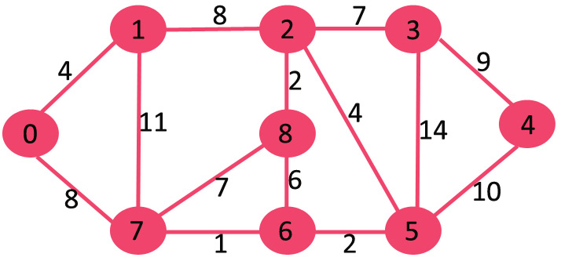
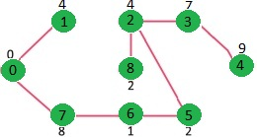
Minimum Cost Spanning Tree: Prim’s Algorithm
Designed by Robert C. Prim in 1957 and was modified by Dijkstra so also called as DJP algorithm.

Slide 31
Proof of Correctness: Prims’ Algorithm
The proof of prims’ algorithms is described using CUT property of a graph.
Let G=(V,E) be the graph, then CUT property will divide the graph into two sets of vertices (X and V-X), such that there exists three types of edges.
Edges with both vertices in “X”
Edges with both vertices in “V-X”
Edges with one vertex in “X” and one vertex in “V-X” ➔ Crossing edge
If there are “n” vertices in graph, then number of cuts will be 2^{n}
Empty cut lemma:
A graph is said to be not connected, if cut has no crossing edges. This is denoted as empty cut.
The correctness is proved using straight forward induction method.

