Slide 1
RB Tree Rotation

Slide 2
Left Rotation: Sample example of RB Tree

Slide 3
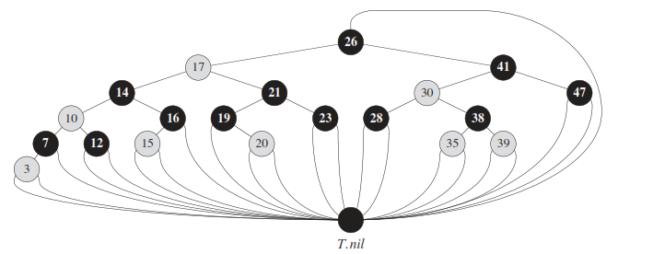
Logic of T.nil

Slide 4
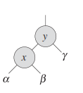
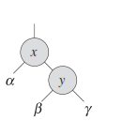
Left Rotation: Assume Sub tree component
Left Rotation for node X

Slide 5
Right Rotation: Assume Sub tree component
Right Rotation on Y

Slide 6
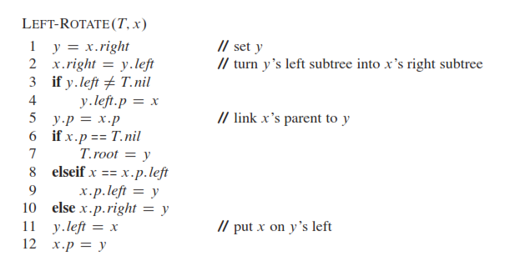
Left Rotation Algorithm

Slide 7
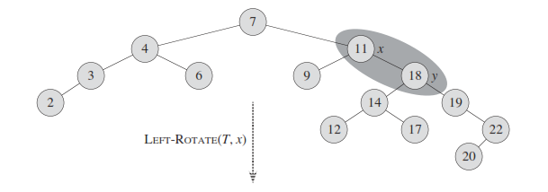
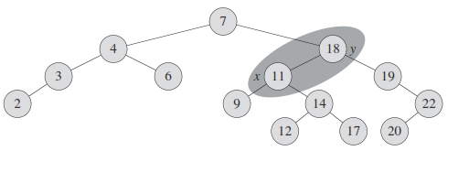
Example: 1: Left Rotation

