Slide 1
Priority Search Tree
M.B.Chandak
hodcs@rknec.edu
www.mbchandak.com

Slide 2
Priority Search Tree [PST]
PST = Data structure to store the (x,y) values based on fixed defined priorities.
Priorities – can be value of “X” or value of “Y”
Application:
To find out range of values between X1 – X2 and Y1 – Y2
How it is different than Range Tree:
Generally it is designed using either “X” or “Y” values. Whereas range tree uses both “X” and “Y” alternately.
Classified as binary tree.

Slide 6
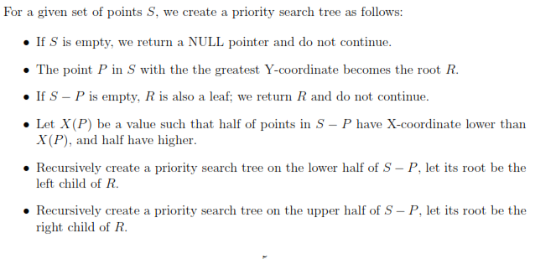
Priority Search Tree: Construction Algorithm

Slide 8
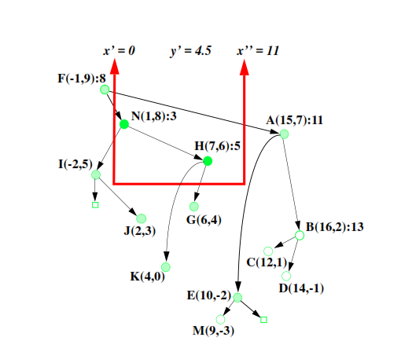

Slide 11
